Slide 1
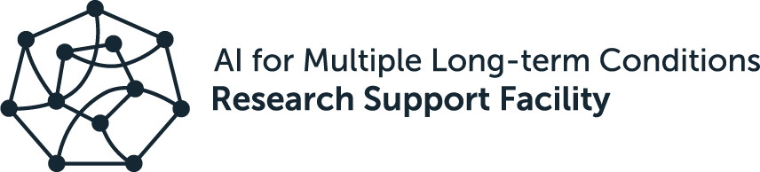
Introduction to GitHub.
Eirini Zormpa, 28 June 2023

Slide 2
Summary of last week
✅ Version control is an approach to recording changes in file(s) over time so that you can track their history, review changes, and go back to earlier versions.
✅ Git is a version control system (arguably the most popular)
✅ You can use git locally on your computer through the command line, specialised GUIs, or plug-ins for IDEs, but you can also use git online
✅ You learned how to start tracking files, save the edits that you made to them, and revert to earlier versions

Slide 3
Questions from last time?

Slide 4

Learning objectives
Materials partly based on Code Refinery, esp. the lesson Introduction to version control with Git
By the end of this session, you’ll be able to:
Explain what GitHub is and why it’s useful
Connect local and GitHub repositories
Understand what branches are and when to use them
Create and merge branches
Open and merge pull requests

Slide 5

Working on GitHub.

Slide 6
My git & GitHub journey
Community Manager Open Collaboration
Trainer on Research Data Management and Open Science
PhD Psycholinguistics
MSc Language Sciences
BA English Language and Literature

Slide 7




Person 3
Suggests a change but doesn’t edit the files
Person 1, 2 & 3
script
script-v2
script-v3
Meta document
Project history
?
Next steps
Person 1
Resources
Person 4
Bugs
Person 2
script-v2_test-new-feature
?
script-workflow
Helps with testing new feature
Slide is intentionally overwhelming & horrible to look at

Slide 8

GitHub
enter the octocat!
Git is super useful for working locally on your own computer, but it falls short if you want to collaborate on a project with other people or even if you want to work on your own from two devices.
GitHub is a popular website for hosting and sharing online projects you have been tracking with git ✨

Slide 9
Benefits of GitHub
Much easier to collaborate when everyone has access to the same repository

Slide 10
Benefits of GitHub
Much easier to collaborate when everyone has access to the same repository
Robust annotation of contributions

Slide 11
Benefits of GitHub
Much easier to collaborate when everyone has access to the same repository
Robust annotation of contributions
Advanced permission options in terms of setting who can see, edit, and manage repositories

Slide 12
Benefits of GitHub
Much easier to collaborate when everyone has access to the same repository
Robust annotation of contributions
Advanced permission options in terms of setting who can see, edit, and manage repositories
Functionality to record issues and bugs, as well as to have discussions with the community that uses the repository

Slide 13
Benefits of GitHub
Much easier to collaborate when everyone has access to the same repository
Robust annotation of contributions
Advanced permission options in terms of setting who can see, edit, and manage repositories
Functionality to record issues and bugs, as well as to have discussions with the community that uses the repository
Functionality for project management

Slide 14
Benefits of GitHub
Much easier to collaborate when everyone has access to the same repository
Robust annotation of contributions
Advanced permission options in terms of setting who can see, edit, and manage repositories
Functionality to record issues and bugs, as well as to have discussions with the community that uses the repository
Functionality for project management
Continuous integration and continuous development (CI/CD) functionality

Slide 15
Benefits of GitHub
Much easier to collaborate when everyone has access to the same repository
Robust annotation of contributions
Advanced permission options in terms of setting who can see, edit, and manage repositories
Functionality to record issues and bugs, as well as to have discussions with the community that uses the repository
Functionality for project management
Continuous integration and continuous development (CI/CD) functionality

Slide 16
Working on GitHub*.
*with yourself

Slide 17
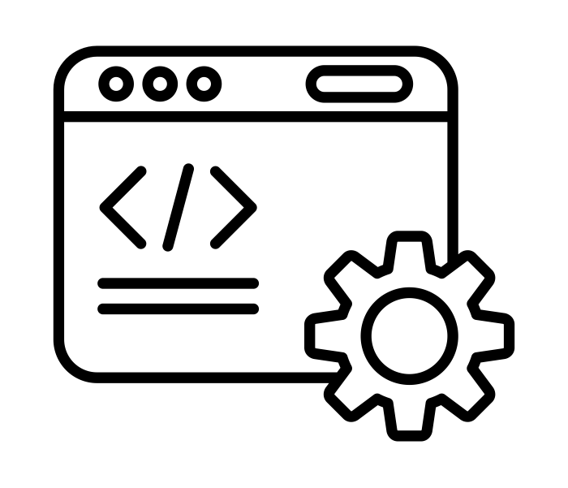
Follow along with me!
Image credit: coding by putrakali735 from The Noun Project shared under a CC-BY 3.0 licence.

Slide 18
Keeping things private 🙊
.gitignore
This is a hidden file that keeps git from tracking files altogether.
Good files (or folders) to add there: data, files about the workings of your computer (e.g. DS_Store on Macs)
Private repos
An option offered by GitHub to give you control over who can view your projects.
Often a temporary stage before publishing projects
Note that even in public repos, you control who can contribute to your repo.

Slide 19



fetch, pull, push
Much simplification!
GitHub
origin
your laptop
working directory
commit
.git
Image credit: laptop by Akshar Pathak, folder by rukanicon, cloud from Hasna ZF from The Noun Project shared under a CC-BY 3.0 licence.

Slide 20
fetch, pull, push
Much simplification!
GitHub
pull
origin
your laptop
merge
working directory
push
fetch
.git
Image credit: laptop by Akshar Pathak, folder by rukanicon, cloud from Hasna ZF from The Noun Project shared under a CC-BY 3.0 licence.

Slide 21
Questions?

Slide 22

Break.
Image credit: Coffee break by Mindspace Studio on Unsplash, shared under the Unsplash licence

Slide 23

Working with branches.
Image credit: Tree Branches by Olena Panasovska from The Noun Project shared under a CC-BY 3.0 licence.

Slide 24
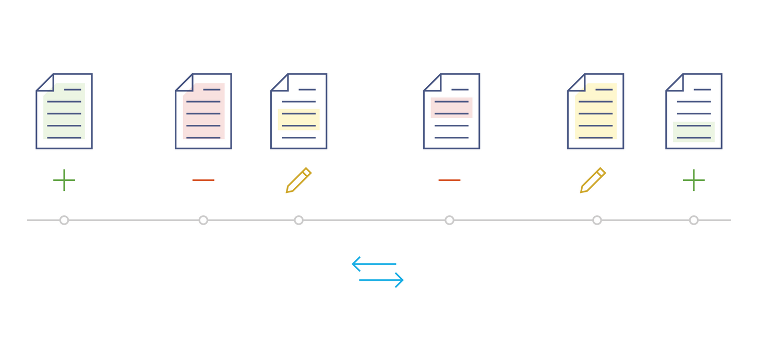
Linear workflow
Image from Chapter 3 of the Mozilla Science Lab's Study Group Orientation handbook, used under a Mozilla Public License Version 2.0.

Slide 25

Linear workflow with GitHub
Image from Chapter 3 of the Mozilla Science Lab's Study Group Orientation handbook, used under a Mozilla Public License Version 2.0.

Slide 26
Branching
experiment
main

Slide 27
Branches help retain a working version of the code, while allowing us to experiment.

Slide 28
Follow along with me!
… and note that the example I’m using is silly
Image credit: coding by putrakali735 from The Noun Project shared under a CC-BY 3.0 licence.

Slide 29

Exercise 1
⏰ 5 minutes
We have already published the recipe-experiment branch to GitHub.
Following the same steps as before:
Make the BT vegetarian and commit your changes to the recipe-experiment branch
Merge the recipe-experiment branch to main and
Push the changes to GitHub

Slide 30
Beware of bugs ❗🐛
Deleting a branch on GitHub doesn’t delete the branch on GitHub Desktop (but the opposite works).

Slide 31

Exercise 2
⏰ 10 minutes
Create a new branch called my-sandwich
Publish the branch on GitHub
Edit the sandwich-recipes.md to include a new recipe
Commit the changes
Push the changes to origin
Open a pull request
Merge the pull request
Delete the branch

Slide 32
Branch usage
Start working with main only
Use branches to test out new ideas and things you’re not sure about
You can merge branches directly to main
Keep main protected
Create branches for changes
Request a review from a collaborator before merging
One-person project 👩‍💻
Multiple-people projects 👩‍💻👩‍💻

Slide 33
Platforms beyond GitHub
GitHub isn’t the only option for working collaboratively with git, though it is the most popular
Other options:
GitLab
BitBucket

Slide 34
Terminology
Remote: a version of your project that is hosted on the Internet (e.g. GitHub) or a network, for the purpose of collaboration
origin: a common name for a remote, typically the one that the project was cloned from
Branch: an independent line of development. Technically, it is a pointer to a specific commit.
main: the default branch name. The default name used to be master.
Merge: an action to incorporate changes from another repository or branch
Pull request: a mechanism to inform others you’ve pushed changes to a repo

Slide 35
Questions?

Slide 36
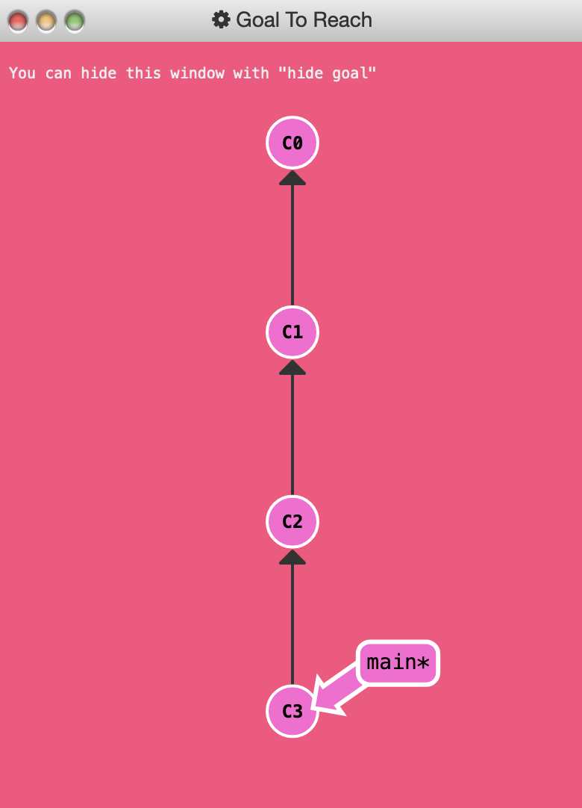
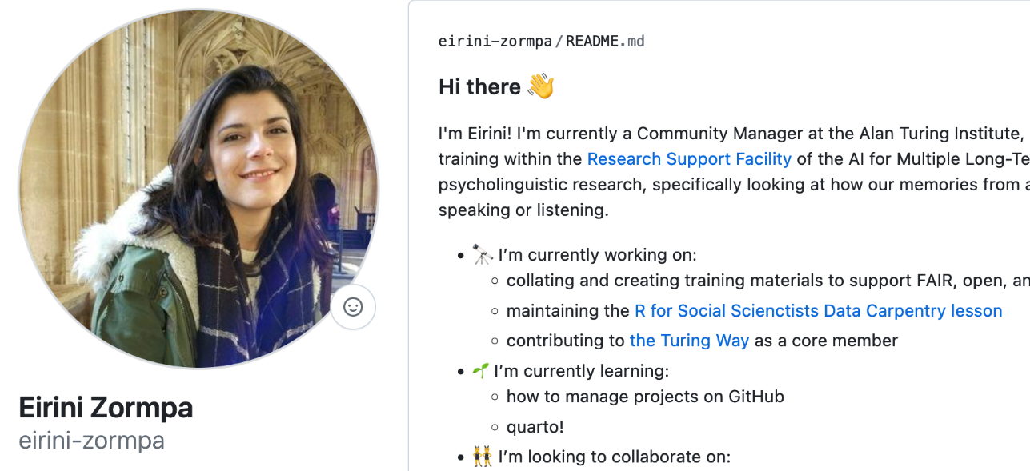
Optional exercise(s)/homework
create a personal README
2. practise git branching

Slide 37


